Slide 1
Computer Graphics and Multimedia PROJECT: - ‘Visual representation of Car stopping due to friction’
Submitted To:-
Kavita Saxena Mam
CGM Prof.
Submitted by:-
Rishabh Gupta, 3C5
10914802720

Slide 2
Project Insight
“Friction is a necessary evil!”
Friction is a major part of our everyday life. Whether it is walking on the road without slipping or driving a nail into a wall, friction is there to help us out.
While it surely cause wear and tear, it is required for some necessary activities, for instance, skating without falling, stopping of a vehicle. Without friction, these activities would prove to be life – threatening.
This project takes into consideration one of these necessary activities:
‘Stopping of a Car due to friction’.
This project demonstrates the hard work of our annoying friend FRICTION to stop a car moving along a rough gravel path.
The source code makes use of user-defined header file named GRAPH.H, the structure of which is described next slide onwards.

Slide 3
Libraries Used: -
stdio.h : This header file in C programming language is designed for doing basic I/O operations.
graphics.h : It is a header file which provides access to a simple graphics library that makes it possible to draw lines, rectangles, ovals, arcs, polygons, images and strings on a graphical window.
dos.h : It is a header file which contains function for handling interrupts, producing sound, date and time functions etc. The functions delay() and kbhit() have been used in this project.
stdlib.h : It stands for Standard Library. It has the information of memory allocation. This header file allows the use of rand() function in this project.
conio.h : It is a header file used in C and CPP and it includes functions like getch() and getche(). It stand for console input output i.e. it takes input from keyboard and display it on screen.

Slide 4
User–Defined Methods: -
The following methods have been defined in GRAPH.H for drawing of some basic structures: -
a) Line: -
void lineDDA(int x1, int y1, int x2, int y2, int COLOR) : A straight line of specified COLOR is drawn from point A(x1, y1) to B(x2, y2) using DDA line drawing algorithm.
void lineBres(int x1, int y1, int x2, int y2, int COLOR): A straight line of specified COLOR is drawn from point A(x1, y1) to B(x2, y2) using Bresenham line drawing algorithm.
b) Rectangle: -
void rec(int left, int top, int right, int bottom, int COLOR) : A rectangle of specified boundary COLOR is drawn with its top-left vertex as (left, top) and bottom-right vertex as (right, bottom).This function makes use of lineDDA for drawing of edges.

Slide 5
User–Defined Methods: -
c) Circle: -
void circleMid(int x, int y, int r, int COLOR) : A circle of specified boundary COLOR, centre point (x, y) and radius r is drawn using Mid-point Circle drawing algorithm.
void circleBres(int x, int y, int r, int COLOR) : A circle of specified boundary COLOR, centre point (x, y) and radius r is drawn using Bresenham Circle drawing algorithm.

Slide 6
DDA Line Drawing Algorithm
Step 1 :- Start
Step 2 :- Declare x0, y0, x1, y1, dx, dy, x, y, i = 1,steps as integer variables.
Step 3 :- Enter Values of x0, y0, x1, y1.
Step 4 :- Calculate dx = x1 – x0 & dy = y1 – y0 .
Step 5 :- If dx > = dy
steps = dx
else
steps = dy .
Step 6 :- dx = dx/steps & dy = dy/steps .
Step 7 :- Assign x = x0 & y = y0.
Step 8 :- setpixel(x, y, Color)
x = x + dx & y = y + dy .
Step 9 :- Repeat Step 8 until x = x1 .
Step 10 :- End.

Slide 7
Bresenham Line Drawing Algorithm
Step 1 :- Start
Step 2 :- Declare variables x1, y1, x2, y2, m, x, u, p, dx, dy, end
Step 3 :- Calculate dx = x2 – x1 & dy = y2 – y1
Then m = dx / dy
Step 4 :- If m > = 0 then
Case A :- If m < 1
i) :- Now If x1 > x2 then, x = x2 & end = x1.
else x = x1 & end = x2.
ii) :- Calculate dx = abs(x2 – x1)
dy = abs(y2 – y1)
p = 2*dy – dx.
iii) :- If p > 0
x = x + 1, y = y + 1 & p = p + 2*(dy – dx)
else
x = x + 1 & p = p + 2*dy.
iv) :- Repeat Step iii) until x < = end.

Slide 8
Bresenham Line Drawing Algorithm
Case B :- If m > 1
i) :- If y1 > y2 then, y = y2 & end = y1
else y = y1 & end = y2.
ii) :- Calculate dx = abs(x2 – x1)
dy = abs(y2 – y1)
p = 2*dx – dy.
iii) :- If p > 0
x = x + 1, y = y + 1 & p = p + 2*(dx - d)
else
y = y + 1 & p = p + 2*dx.
iv) :- Repeat Step iii) until y < = end.

Slide 9
Bresenham Line Drawing Algorithm
Step 5 :- If m < 0 Then,
Case A :- If m > = -1
i) :- Repeat the same Step i) and Step ii) as mentioned in Case A of Step 4.
ii) :- If p > 0 then, y = y – 1, x = x + 1 & p = p + 2*(dy - dx)
else x = x + 1 & p = p + 2*dy.
iii) :- Repeat Step ii) until x < end.
Case B :- If m < -1
i) :- Repeat the same Step i) and Step ii) as mentioned in Case B of Step 4.
ii) :- If p > 0 then, x = x – 1, y = y + 1 & p = p + 2*(dx - dy)
else y = y+ 1 & p = p + 2*dx.
iii) :- Repeat Step ii) until x < end.

Slide 10
Mid-Point Circle Drawing Algorithm
Step 1 :- Start
Step 2 :- Declare variable x_centre, y_centre, Rad, x, y & p.
Step 3 :- Assign x = 0, y = Rad & p = 1 – Rad.
Step 4 :- If p > = 0 then
x = x + 1
y = y – 1
p = p + 2*(x - y) + 5
else
p = p + 2x + 3
x = x + 1.
Step 5 :- Repeat Step 4 until x < = y.
Step 6 :- End.

Slide 11
Bresenham Circle Drawing Algorithm
Step 1 :- Start
Step 2 :- Declare variable x_centre, y_centre, Rad, x, y & p.
Step 3 :- Assign x = 0, y = Rad & p = 3 – 2*Rad.
Step 4 :- If p > = 0 then
x = x + 1
y = y – 1
p = p + 4*(x - y) + 10
else
p = p + 4x + 6
x = x + 1.
Step 5 :- Repeat Step 4 until x < = y.
Step 6 :- End.

Slide 12
Description Of Driver Code Methods: -
void car(int x, int y, int BODY_COLOUR, int TYRE_COLOUR):
Draws a car onto the view-port with specified parameter:-
i) x : right-most (rear end) coordinate of car
ii) y : bottom (base of car) coordinate of car
iii) BODY_COLOUR : colour of body of car (except wheels)
iv) TYRE_COLOUR : colour of wheels of car
void road(int height , int COLOR):
Draws a rough gravel path at specified height and of specified COLOR.

Slide 13
Description Of Driver Code Methods: -
void night():
Draws a complete night view with sky full of stars and an adorable moon.
void dust(int height):
Visualize the effect of dust-particles at time of stopping.
void myinfo():
Introduces the creator of the project (of course ME!)
void project info():
Introduces the Project Name in a beautiful way!

Slide 14
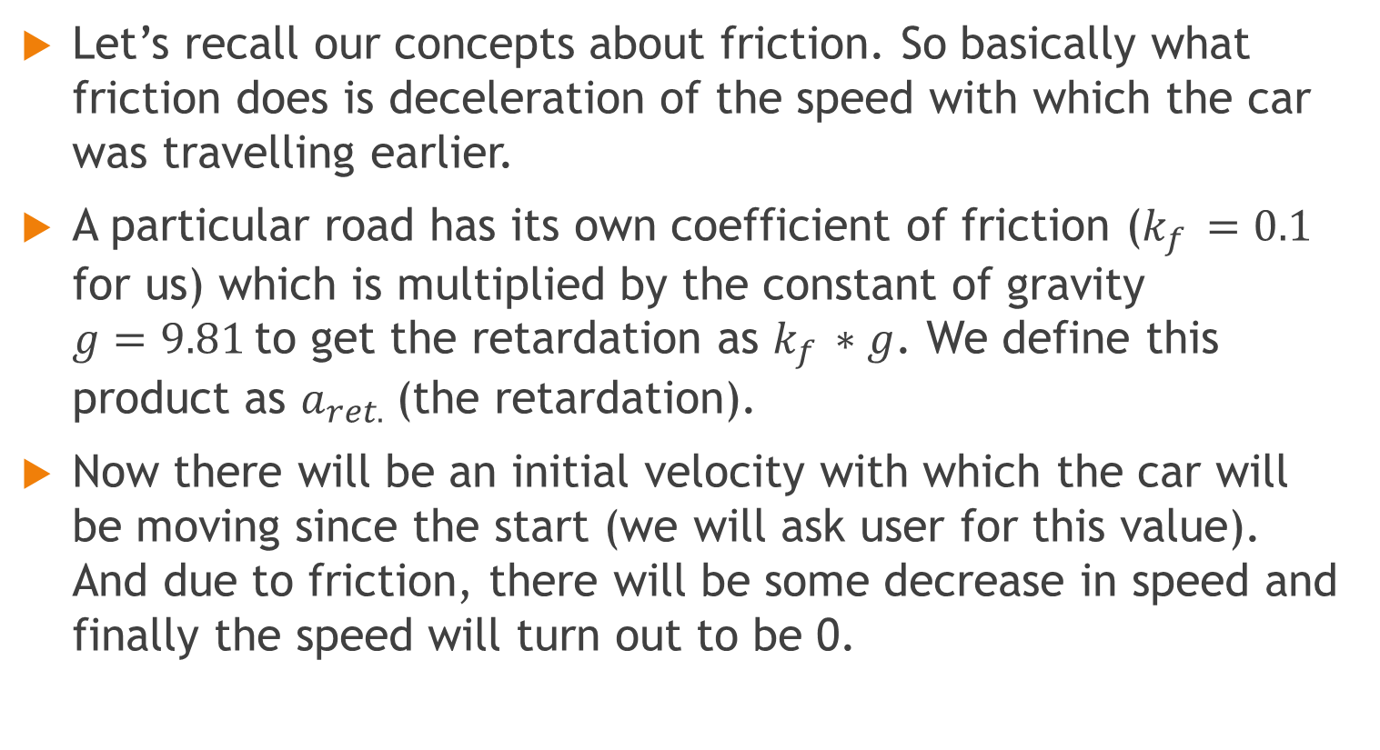
Ideology
Let’s recall our concepts about friction. So basically what friction does is deceleration of the speed with which the car was travelling earlier.
A particular road has its own coefficient of friction ($k_{f }=0.1$ for us) which is multiplied by the constant of gravity $g=9.81$to get the retardation as $k_{f }∗g$. We define this product as $a_{ret.}$(the retardation).
Now there will be an initial velocity with which the car will be moving since the start (we will ask user for this value). And due to friction, there will be some decrease in speed and finally the speed will turn out to be 0.

Slide 15
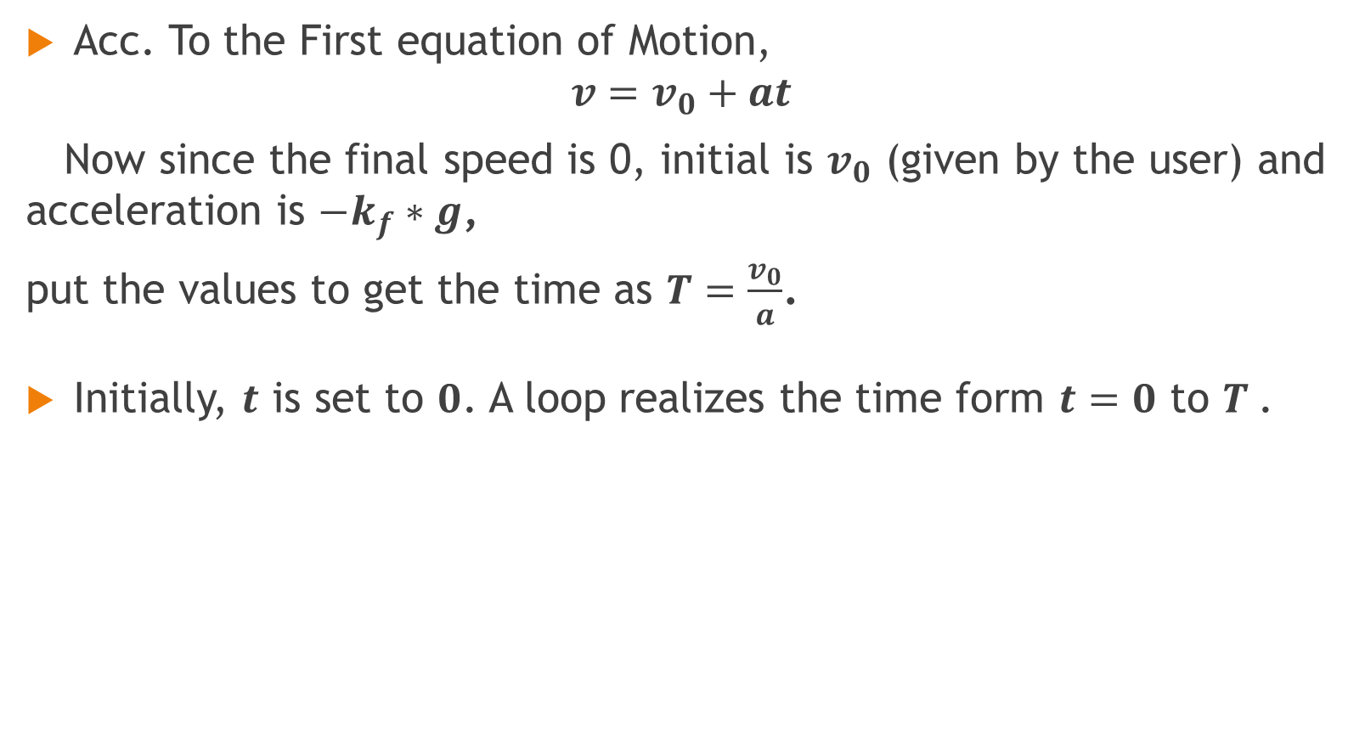
Calculations: -
Acc. To the First equation of Motion,
$$v=v_{0}+at$$
Now since the final speed is 0, initial is $v_{0}$ (given by the user) and acceleration is ${−k}_{f}∗g$,
put the values to get the time as $T=\frac{v_{0}}{a}$.
Initially, $t$ is set to $0$. A loop realizes the time form $t=0$ to $T$.

Slide 16
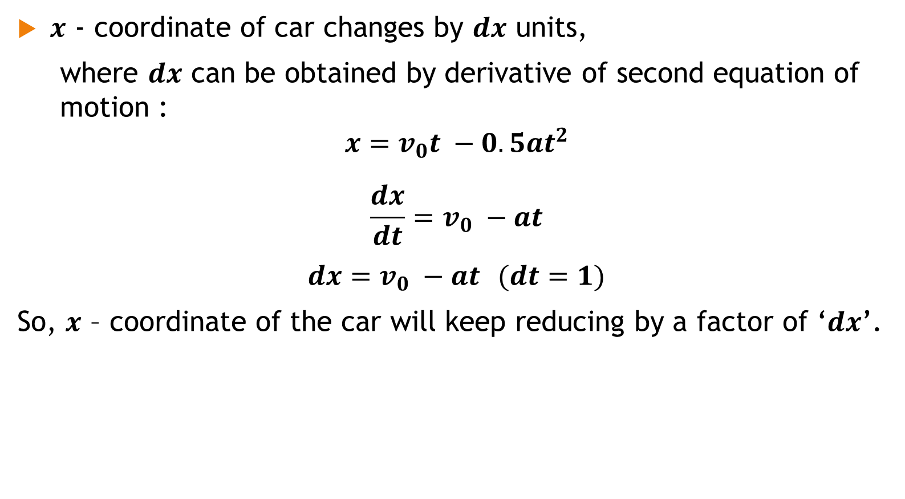
Calculations: -
$x$ - coordinate of car changes by $dx$ units,
where $dx$ can be obtained by derivative of second equation of motion :
$$x=v_{0}t −0.5at^{2}$$
$$\frac{dx}{dt}=v_{0} −at$$
$dx=v_{0} −at$ $(dt=1)$
So, $x$ – coordinate of the car will keep reducing by a factor of ‘$dx$’.

Slide 17
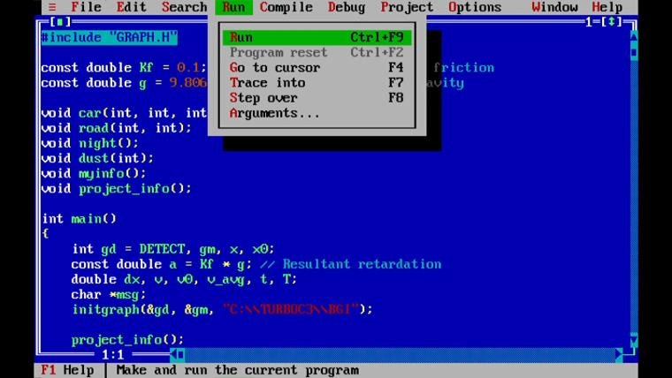
- :Visualization: -

Slide 18


